Slide 1


Final Video Game Project
Zachary Montoya
12-15-22
ECE388

Slide 2
Progress
Multiple Modules and Meteor instantiations
Direction dependent ROMs
Spaceship
Missiles
Text and scoreboard foundation

Slide 3
Multiple Modules
Graph RGB multiplexing added to TOP.vhd
Signals for RGB and the respective RGB-ON from entities
Caution with HDMI driver during save as and copying

Slide 4
Direction dependent ROMs
FSM created with the spaceship entity to track orientation based on button inputs
Orientation signal used to display different ROMs of spaceship within the space and out to the missiles at their No-Fire state.

Slide 5
Missiles
Updates with the location of the ship and direction
Captures the orientation of the ship during fire and maintains during flight via classical start and ready relationship with the spaceships
Funny bugs!

Slide 6
Proposed
Cluster Bombs with use frequency control
Alien enemies under player 2 control anatagonist
Asteroid quantity and velocity increase over time
Asteroid to spaceship gravitational affinity
Alien controlled asteroids
Additional spaceships for player 1 protagonist

Slide 7
Planned
Leverage the update logic from the missile and spaceship to create a collider
During game ramp-up and initiate additional asteroids gradually during start-up with a max of 4
Create a timer to capture startup and normal play allow for X amount of time.
Asteroid velocity increases over time.
Missile hits to asteroid increment score live.
Asteroid hits to ship terminate game prematurely.
At end of timer display score and high score of games played.

Slide 8
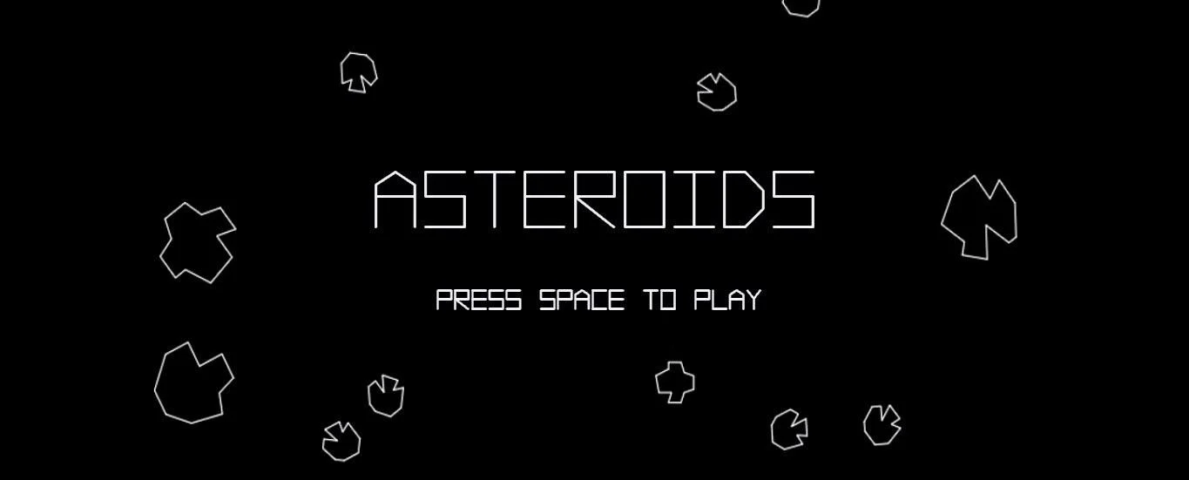
Thank you!

